Slide 1
My absolutely atrocious spring semester class registration
Kevin lei

Slide 2

shoutout new jersey

Slide 3
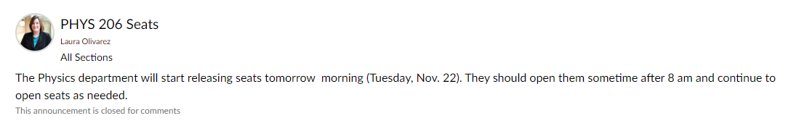
also shoutout to the physics department

Slide 4
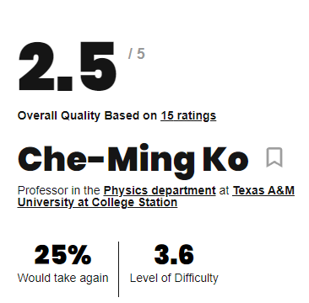
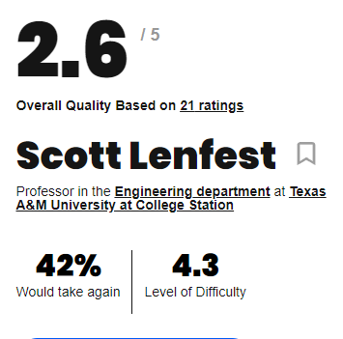

Slide 5

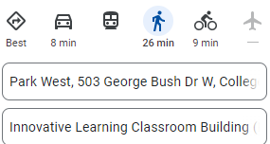
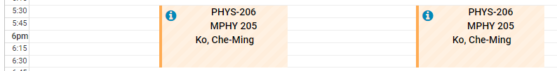
finally got all my classes

